Slide 1
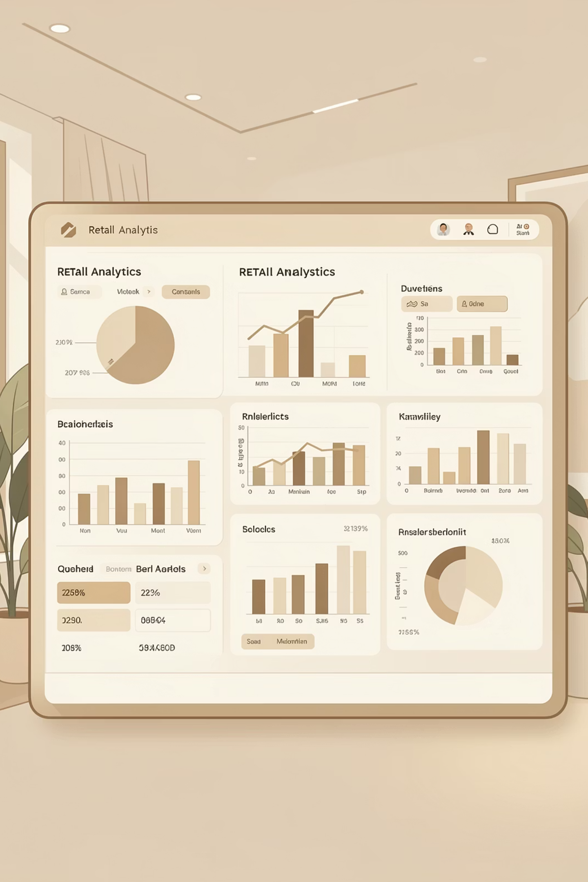
Customer Shopping Behaviour Analysis
Transforming raw customer data into actionable business insights through Python, SQL, and Power BI analytics.

Slide 2

OVERVIEW
Project Scope & Objectives
This project analyzes customer shopping behaviour using transactional and demographic data to understand purchasing patterns, preferences, and revenue contribution.
The analysis integrates three powerful tools to deliver comprehensive insights:
Python for exploratory data analysis
SQL for structured data querying
Power BI for interactive visual analytics

Slide 3

Key Performance Metrics
3.4K
3.76
$59.61
Total Customers
Avg Review Rating
Avg Purchase
Active customer base analyzed
Customer satisfaction score
Per transaction spending

Slide 4

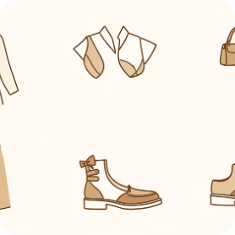
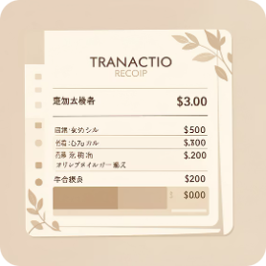

DATASET
Data Structure & Components
Customer Demographics
Product Categories
Transaction Data
Subscription Status
Customer ID, age group, and gender data for segmentation analysis.
Clothing, accessories, footwear, and outerwear purchase records.
Purchase amounts, review ratings, and frequency metrics.
Subscription status and shipping preferences tracked per customer.

Slide 5
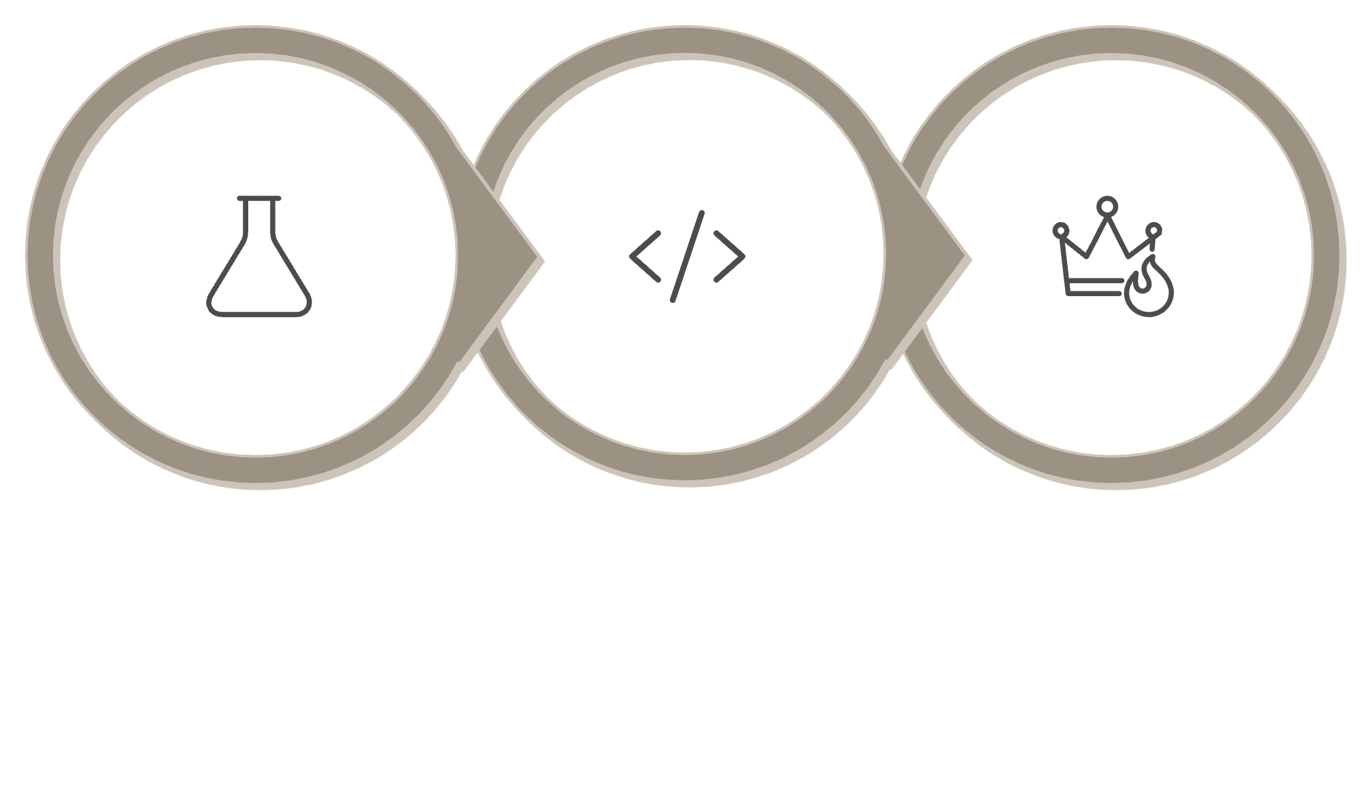

Analysis Methodology
Python EDA
SQL Queries
Power BI
Our comprehensive approach combines exploratory data analysis, structured querying, and visual analytics to extract meaningful patterns from customer behaviour data.

Slide 6
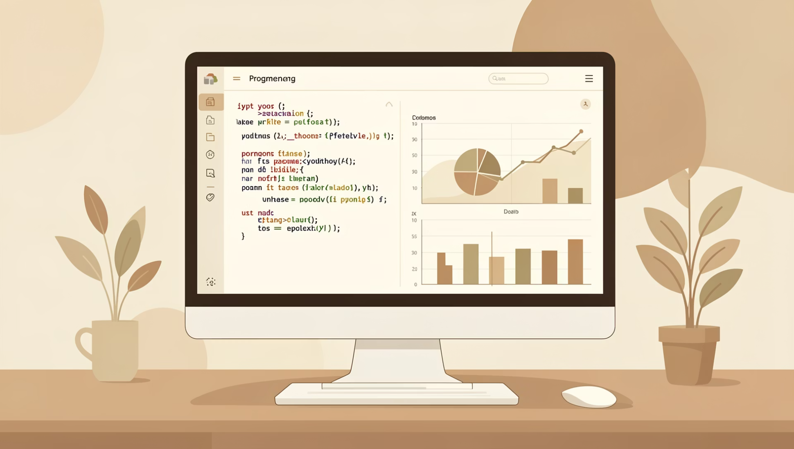
PYTHON EDA
Exploratory Data Analysis Findings
Data Quality
Cleaned missing values, removed duplicates, standardized labels.
Rating Patterns
Most ratings between 3.5-4, indicating good satisfaction.
Age Insights
Middle-age groups show highest purchasing consistency.
Category Trends
Clothing and accessories dominate purchase frequency.

Slide 7
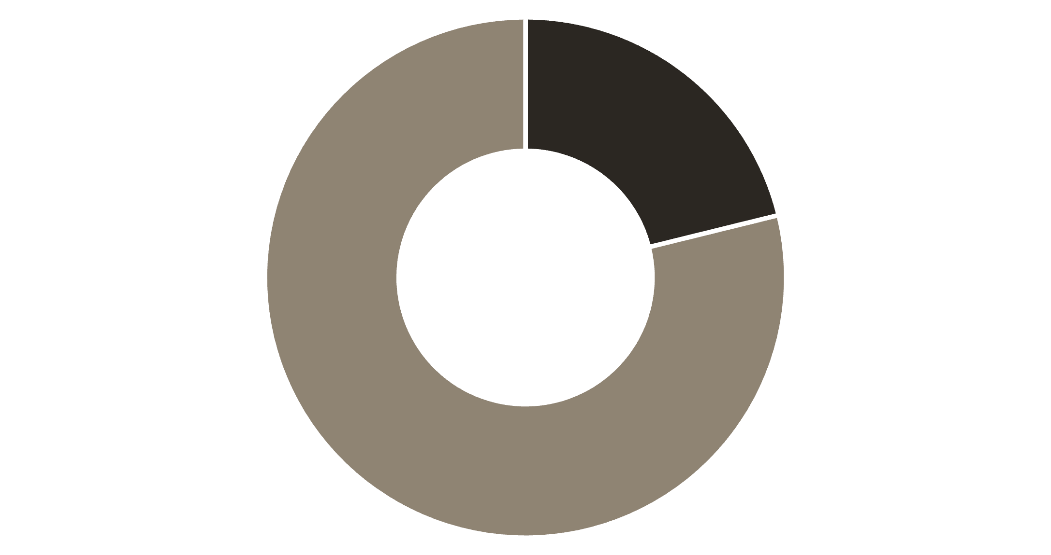
Subscription Status Distribution
Major Growth Opportunity
Non-subscribers represent 79% of the customer base, indicating strong potential to grow revenue through subscription-based offers and loyalty programs.
Subscribed customers contribute relatively higher average spending, making subscription conversion a key strategic priority.
Subscribed
Non-Subscribed

Slide 8
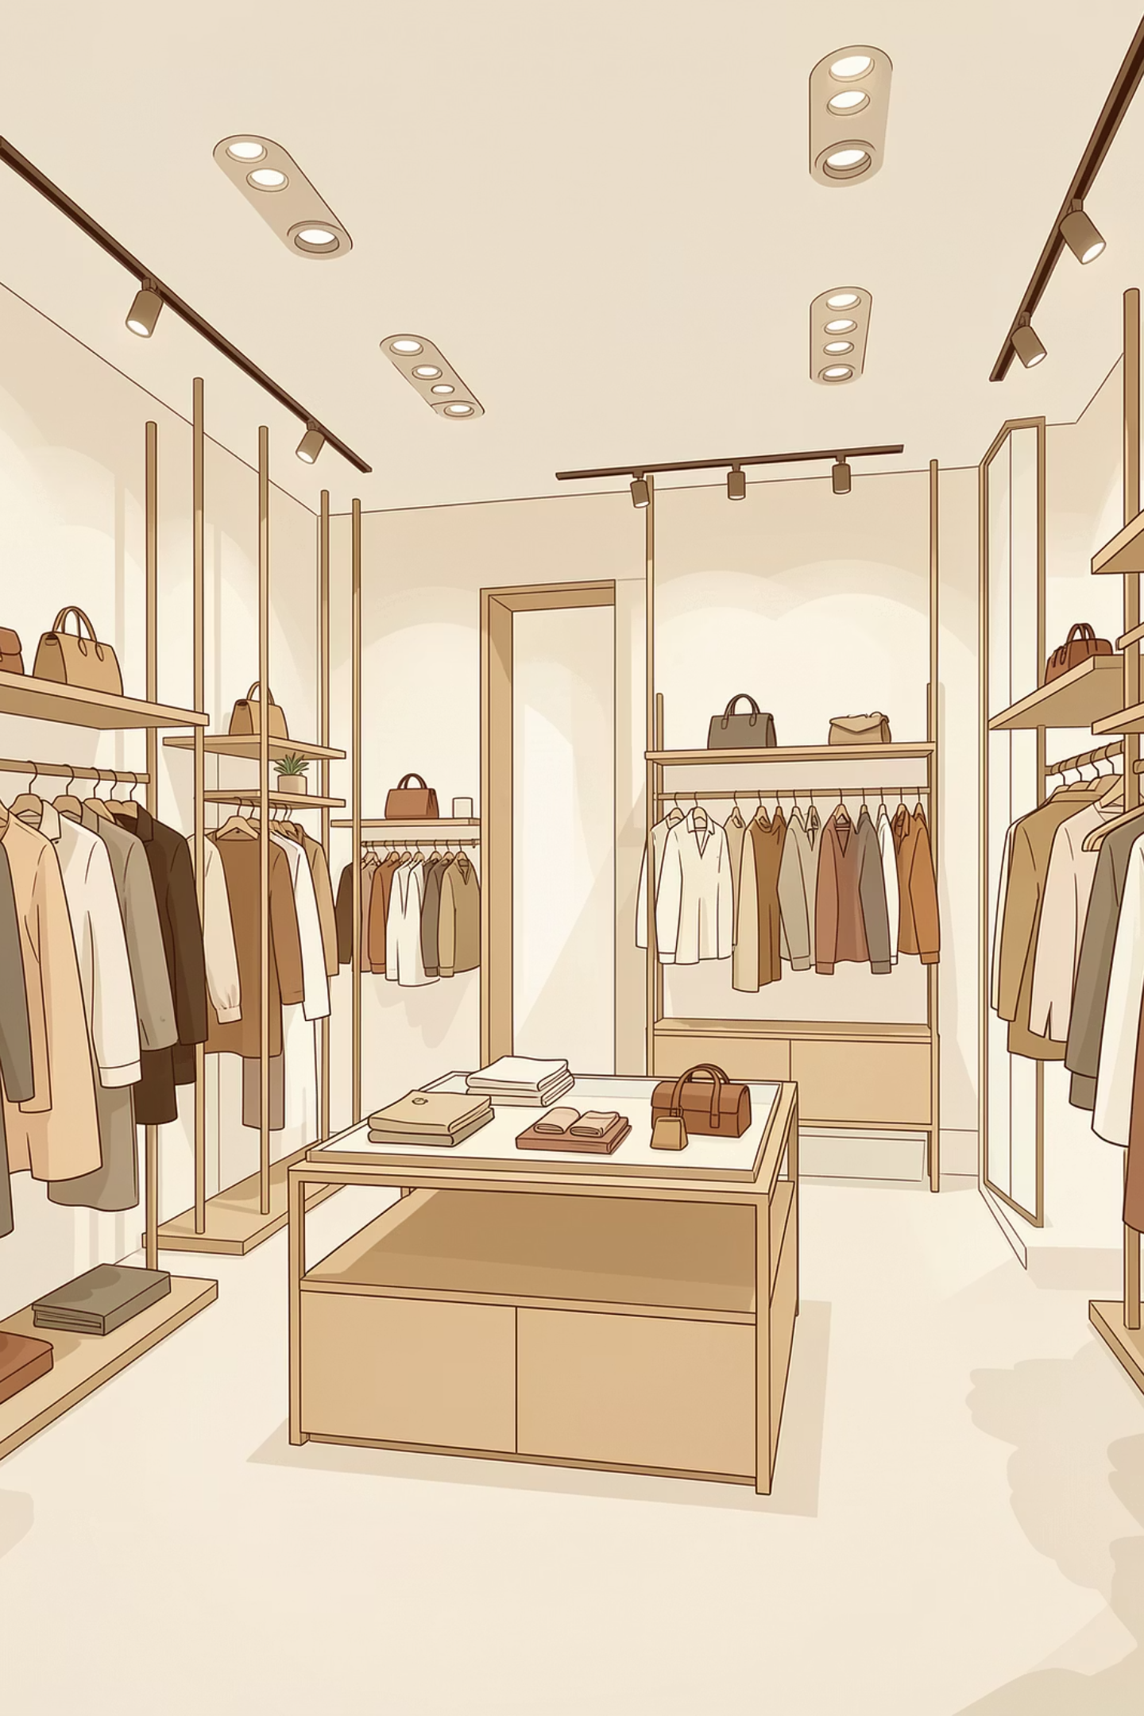
Revenue & Sales by Category
Clothing
Accessories
Footwear
Highest revenue generator and sales volume leader across all categories.
Second-highest revenue contributor with moderate sales volume.
Lower revenue contribution with limited demand patterns.
Outerwear
Lowest performing category requiring strategic intervention.

Slide 9




RECOMMENDATIONS
Strategic Business Actions
Boost Subscriptions
Expand Top Categories
Introduce loyalty rewards, exclusive discounts, and free shipping for subscribers.
Increase clothing and accessories inventory with targeted promotions.
Age-Based Marketing
Revive Low Performers
Personalized offers for middle-age customers, budget deals for younger segments.
Bundle footwear and outerwear with popular items, offer seasonal discounts.

Slide 10
Conclusion & Impact
This project demonstrates the power of combining Python EDA, SQL analysis, and Power BI visualization to analyze customer shopping behaviour effectively.
Next Steps
Implement subscription campaigns
Optimize category inventory
Launch age-targeted marketing
Monitor satisfaction metrics
The interactive dashboard provides clear insights into customer preferences, revenue drivers, and subscription patterns, enabling businesses to make informed, data-driven decisions.
Key Takeaway: Middle-age customers drive revenue, clothing dominates sales, and subscription conversion represents the biggest growth opportunity.

